Slide 1
GraphX: Graph Analytics on Spark
Joseph Gonzalez, Reynold Xin,
Ion Stoica, Michael Franklin
Developed at the UC Berkeley AMPLab
AMPCamp: August 29, 2013

Slide 2
Graphs are Essential to Data Mining and Machine Learning
Identify influential people and information
Find communities
Understand people’s shared interests
Model complex data dependencies

Slide 3



Predicting Political Bias
?
?
Liberal
Conservative
?
?
?
?
?
?
?
?
Post
?
Post
?
Post
Post
?
Post
Post
Post
Post
?
Post
Post
Post
Post
?
Post
?
Post
?
?
?
?
?
Post
?
Post
Post
Post
Conditional Random Field
Belief Propagation
Post
Post
Post
?
Post
?
?
?
?
?
?
?

Slide 4
Triangle Counting
Count the triangles passing through each vertex:
Measures “cohesiveness” of local community
2
3
1
4
Fewer Triangles
Weaker Community
More Triangles
Stronger Community

Slide 5






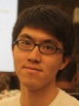



Collaborative Filtering
Users
Ratings
Items

Slide 6
Many More Graph Algorithms
Collaborative Filtering
Alternating Least Squares
Stochastic Gradient Descent
Tensor Factorization
SVD
Structured Prediction
Loopy Belief Propagation
Max-Product Linear Programs
Gibbs Sampling
Semi-supervised ML
Graph SSL
CoEM
Graph Analytics
PageRank
Single Source Shortest Path
Triangle-Counting
Graph Coloring
K-core Decomposition
Personalized PageRank
Classification
Neural Networks
Lasso
…

Slide 7

Structure of Computation
Data-Parallel
Graph-Parallel
Table
Dependency Graph
Row
Row
Result
Row
Row
Pregel

Slide 8
The Graph-Parallel Abstraction
A user-defined Vertex-Program runs on each vertex
Graph constrains interaction along edges
Using messages (e.g. Pregel [PODC’09, SIGMOD’10])
Through shared state (e.g., GraphLab [UAI’10, VLDB’12])
Parallelism: run multiple vertex programs simultaneously

Slide 9
By exploiting graph-structure Graph-Parallel systems can be orders-of-magnitude faster.

Slide 10
Triangle Counting on Twitter
40M Users, 1.4 Billion Links
Counted: 34.8 Billion Triangles
Hadoop [WWW’11]
1536 Machines
423 Minutes
64 Machines
15 Seconds
1000 x Faster
GraphLab
S. Suri and S. Vassilvitskii, “Counting triangles and the curse of the last reducer,” WWW’11

Slide 11



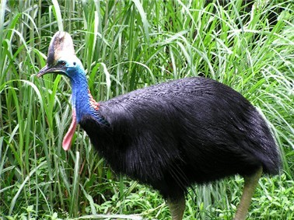

Specialized Graph Systems
Pregel

Slide 12
Specialized Graph Systems
APIs to capture complex graph dependencies
Exploit graph structure to reduce communication and computation

Slide 13
Why GraphX?

Slide 14
The Bigger Picture
Post
Proc.
Hadoop Graph Algorithms
Graph Lab
Graph Creation
Time Spent in Data Pipeline

Slide 15
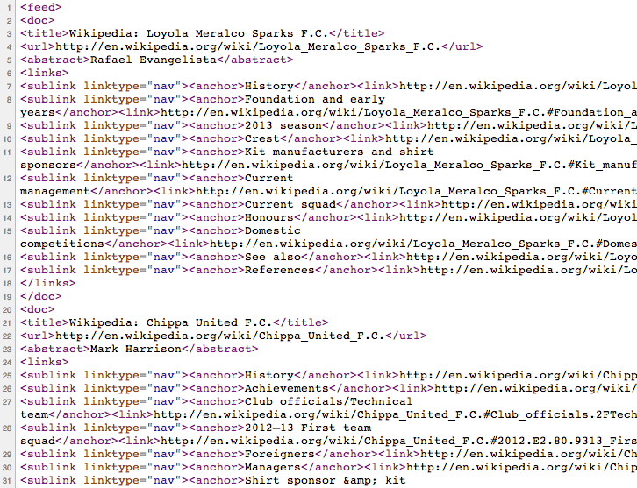

Slide 16
Vertices

Slide 17
Edges
Edges

Slide 18
Limitations of Specialized Graph-Parallel Systems
No support for Construction & Post Processing
Not interactive
Requires maintaining multiple platforms
Spark excels at these!

Slide 19
GraphX Unifies Data-Parallel and Graph-Parallel Systems
Spark Table API
RDDs, Fault-tolerance, and task scheduling
GraphLab Graph API
graph representation and execution
one system for the entire graph pipeline
Graph Construction
Computation
Post-Processing

Slide 20
Enable Joining Tables and Graphs
ETL
Join
Inf.
User
Data
Friend Graph
Product Rec.
Graph
Prod.
Rec.
Tables Graphs
Product
Ratings

Slide 21
The GraphX Resilient Distributed Graph
Id
Rxin
Jegonzal
Franklin
Istoica
Attribute (V)
(Stu., Berk.)
(PstDoc, Berk.)
(Prof., Berk)
(Prof., Berk)
R
F
J
I
SrcId | DstId
rxin | jegonzal
franklin | rxin
istoica | franklin
franklin | jegonzal
Attribute (E)
Friend
Advisor
Coworker
PI

Slide 22
GraphX API
class Graph [ V, E ] {
// Table Views -----------------
def vertices: RDD[ (Id, V) ]
def edges: RDD[ (Id, Id, E) ]
def triplets: RDD[ ((Id, V), (Id, V), E) ]
// Transformations ------------------------------
def reverse: Graph[V, E]
def filterV(p: (Id, V) => Boolean): Graph[V,E]
def filterE(p: Edge[V,E] => Boolean): Graph[V,E]
def mapV[T](m: (Id, V) => T ): Graph[T,E]
def mapE[T](m: Edge[V,E] => T ): Graph[V,T]
// Joins ----------------------------------------
def joinV[T](tbl: RDD[(Id, T)]): Graph[(V, Opt[T]), E ]
def joinE[T](tbl: RDD[(Id, Id, T)]): Graph[V, (E, Opt[T])]
// Computation ----------------------------------
def aggregateNeighbors[T](mapF: (Edge[V,E]) => T, reduceF: (T, T) => T, direction: EdgeDir): Graph[T, E]
}

Slide 23
Aggregate Neighbors
Map-Reduce for each vertex
B
C
mapF( )
a₁
A
B
A
mapF( )
a₂
A
C
D
E
reduceF( , )
A
a₁
a₂
F

Slide 24
Example: Oldest Follower
23
42
What is the age of the oldest follower for each user?
val followerAge = graph.aggNbrs( e => e.src.age, // MapF max(_, _), // ReduceF InEdges).vertices
B
C
30
A
D
19
E
75
F
16

Slide 25
We can express both Pregel and GraphLab using aggregateNeighbors in 40 lines of code!

Slide 26
Performance Optimizations
Replicate & co-partition vertices with edges
GraphLab (PowerGraph) style vertex-cut partitioning
Minimize communication by avoiding edge data movement in JOINs
In-memory hash index for fast joins

Slide 27
Early Performance

Slide 28
In Progress Optimizations
Byte-code inspection of user functions
E.g. if mapf does not need edge data, we can rewrite the query to delay the join
Execution strategies optimizer
Scan edges randomly accessing vertices
Scan vertices randomly accessing edges

Slide 29
Current Implementation
PageRank (5)
Connected Comp. (10)
Shortest Path (10)
ALS
(40)
Pregel (20)
GraphLab (20)
GraphX
Spark (relational operators)

Slide 30
Demo
Reynold Xin

Slide 31
vertices = spark.textFile("hdfs://path/pages.csv")
edges = spark.textFile("hdfs://path/to/links.csv”)
.map(line => new Edge(line.split(‘\t’))
g = new Graph(vertices, edges).cache
println(g.vertices.count)
println(g.edges.count)
g1 = g.filterVertices(_.split('\t')(2) == "Berkeley")
ranks = Analytics.pageRank(g1, numIter = 10)
println(ranks.vertices.sum)

Slide 32
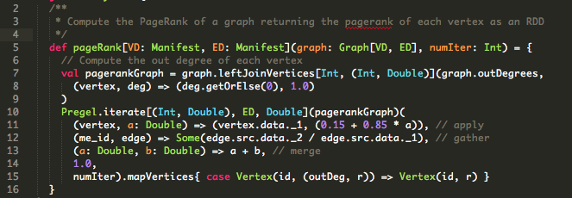
ranks = Analytics.pageRank(g1, numIter = 10)
println(ranks.vertices.sum)

Slide 33
Summary
Graph-parallel primitives on Spark.
Currently slower than GraphLab, but
No need for specialized systems
Easier ETL, and easier consumption of output
Interactive graph data mining
Future work will bring performance closer to specialized engines.
Notes:
Sub-second

Slide 34
Status
Currently finalizing the APIs
Feedback wanted: http://bit.ly/graph-api
Also working on improving system performance
Will be part of Spark 0.9

Slide 35
Questions?
jegonzal@eecs.berkeley.edu
rxin@eecs.berkeley.edu

Slide 36
Backup slides

Slide 37
Vertex Cut Partitioning

Slide 38
Vertex Cut Partitioning

Slide 39
aggregateNeighbors

Slide 40
aggregateNeighbors

Slide 41
aggregateNeighbors

Slide 42
aggregateNeighbors

Slide 43
Example: Vertex Degree

Slide 44
Example: Vertex Degree

Slide 45
Example: Vertex Degree
A: 5
B: 0
C: 0
D: 0
E: 0
F: 0

Slide 46
Example: Oldest Follower
What is the age of the oldest follower for each user?
val followerAge = graph.aggNbrs( e => e.src.age, // MapF max(_, _), // ReduceF InEdges).vertices
B
C
A
D
E
F

Slide 47
Specialized Graph Systems
Pregel
Messaging
[PODC’09, SIGMOD’10]
Shared State
[UAI’10, VLDB’12]
Many Others
Giraph, Stanford GPS, Signal-Collect,
Combinatorial BLAS, BoostPGL, …

Slide 48
The Challenge
Expressive graph computation primitives implementable on Spark
Leveraging advanced properties and engine extensions to make these primitives fast
An optimizer for choosing execution strategies
Controlled data partitioning
New index-based access methods and operators

Slide 49
GraphX API
class Graph [ V, E ] {
// Table Views -----------------
def vertices: RDD[ (Id, V) ]
def edges: RDD[ (Id, Id, E) ]
def triplets: RDD[ ((Id, V), (Id, V), E) ]
// Transformations ------------------------------
def reverse: Graph[V, E]
def filterV(p: (Id, V) => Boolean): Graph[V,E]
def filterE(p: Edge[V,E] => Boolean): Graph[V,E]
def mapV[T](m: (Id, V) => T ): Graph[T,E]
def mapE[T](m: Edge[V,E] => T ): Graph[V,T]
// Joins ----------------------------------------
def joinV[T](tbl: RDD[(Id, T)]): Graph[(V, Opt[T]), E ]
def joinE[T](tbl: RDD[(Id, Id, T)]): Graph[V, (E, Opt[T])]
// Computation ----------------------------------
def aggregateNeighbors[T](mapF: (Edge[V,E]) => T, reduceF: (T, T) => T, direction: EdgeDir): Graph[T, E]
}

